Slide 1
Story #9
Danger in the Lake

Slide 2
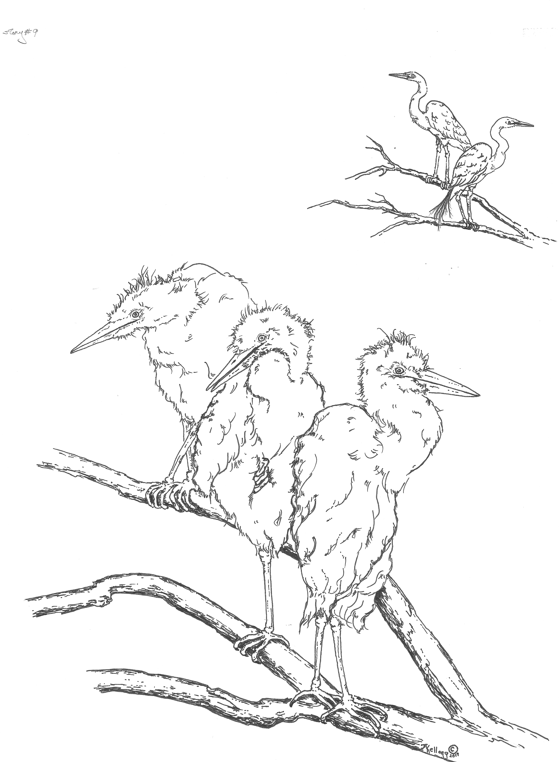

Slide 3

Story #9:Danger in the Lake

Slide 4

After a month, the baby chicks are able to can hop to a nearby branch.

Slide 5
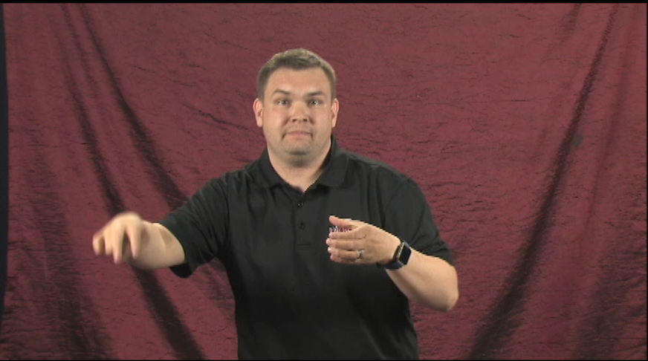
They hop in and out of the nest, flapping their little wings.

Slide 6

But they cannot fly.

Slide 7
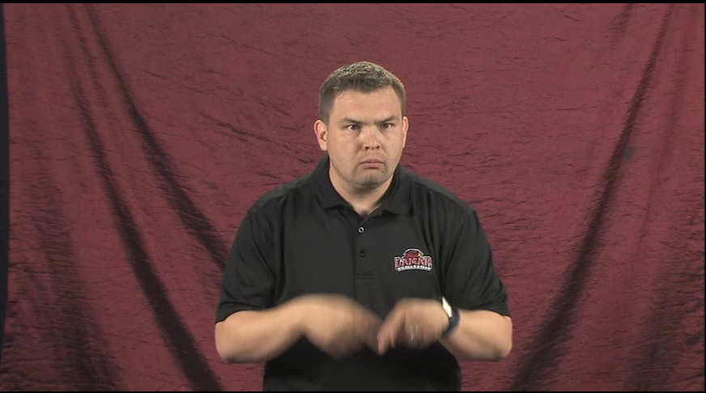
The baby chicks grow bigger and bigger but still they cannot fly.

Slide 8
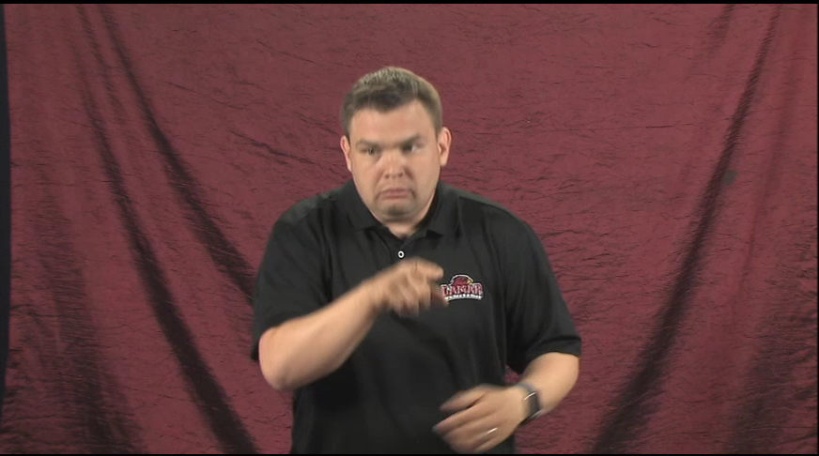
And the lake is not a safe place.

Slide 9
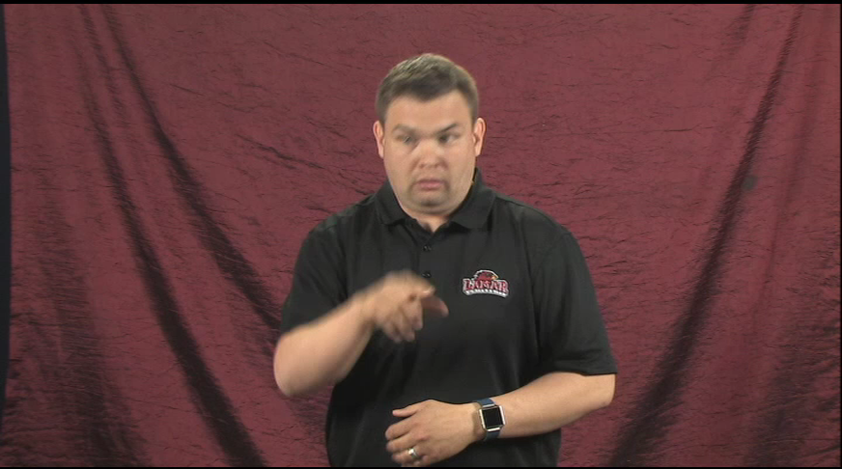
Down below there are alligators with sharp teeth looking for baby birds to eat.

Slide 10
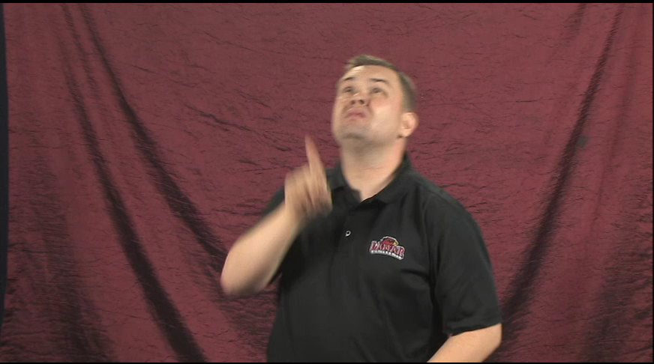
Up above there are eagles with sharp eyes looking for baby birds to eat.

Slide 11
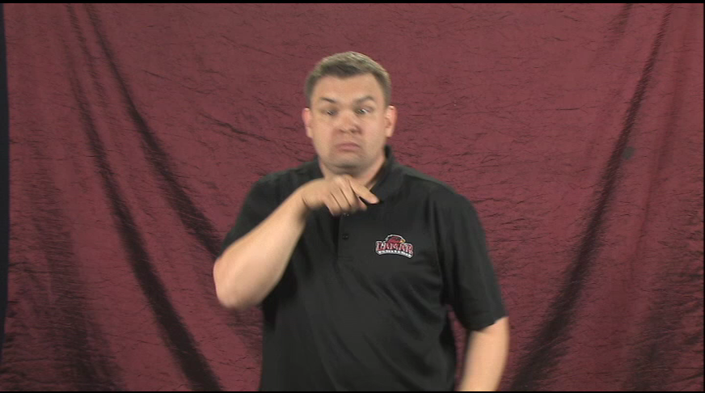
And all around the lake and bayou, bobcats hide behind cypress trees waiting to snatch baby birds.

Slide 12
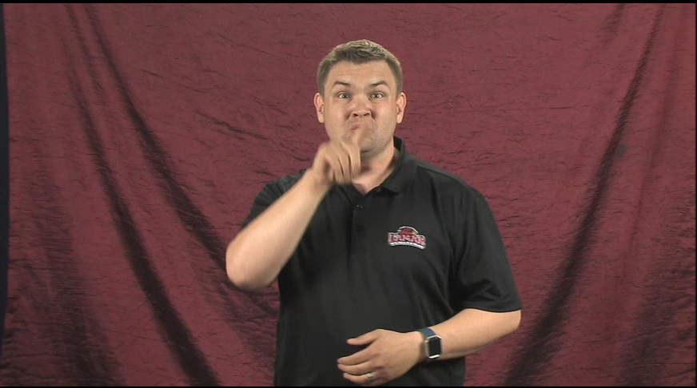
But the chicks cannot fly away from danger, so Mother and Father egret stand guard near the nest.

