Slide 1
Story #6
The Hungry Great Egrets

Slide 2
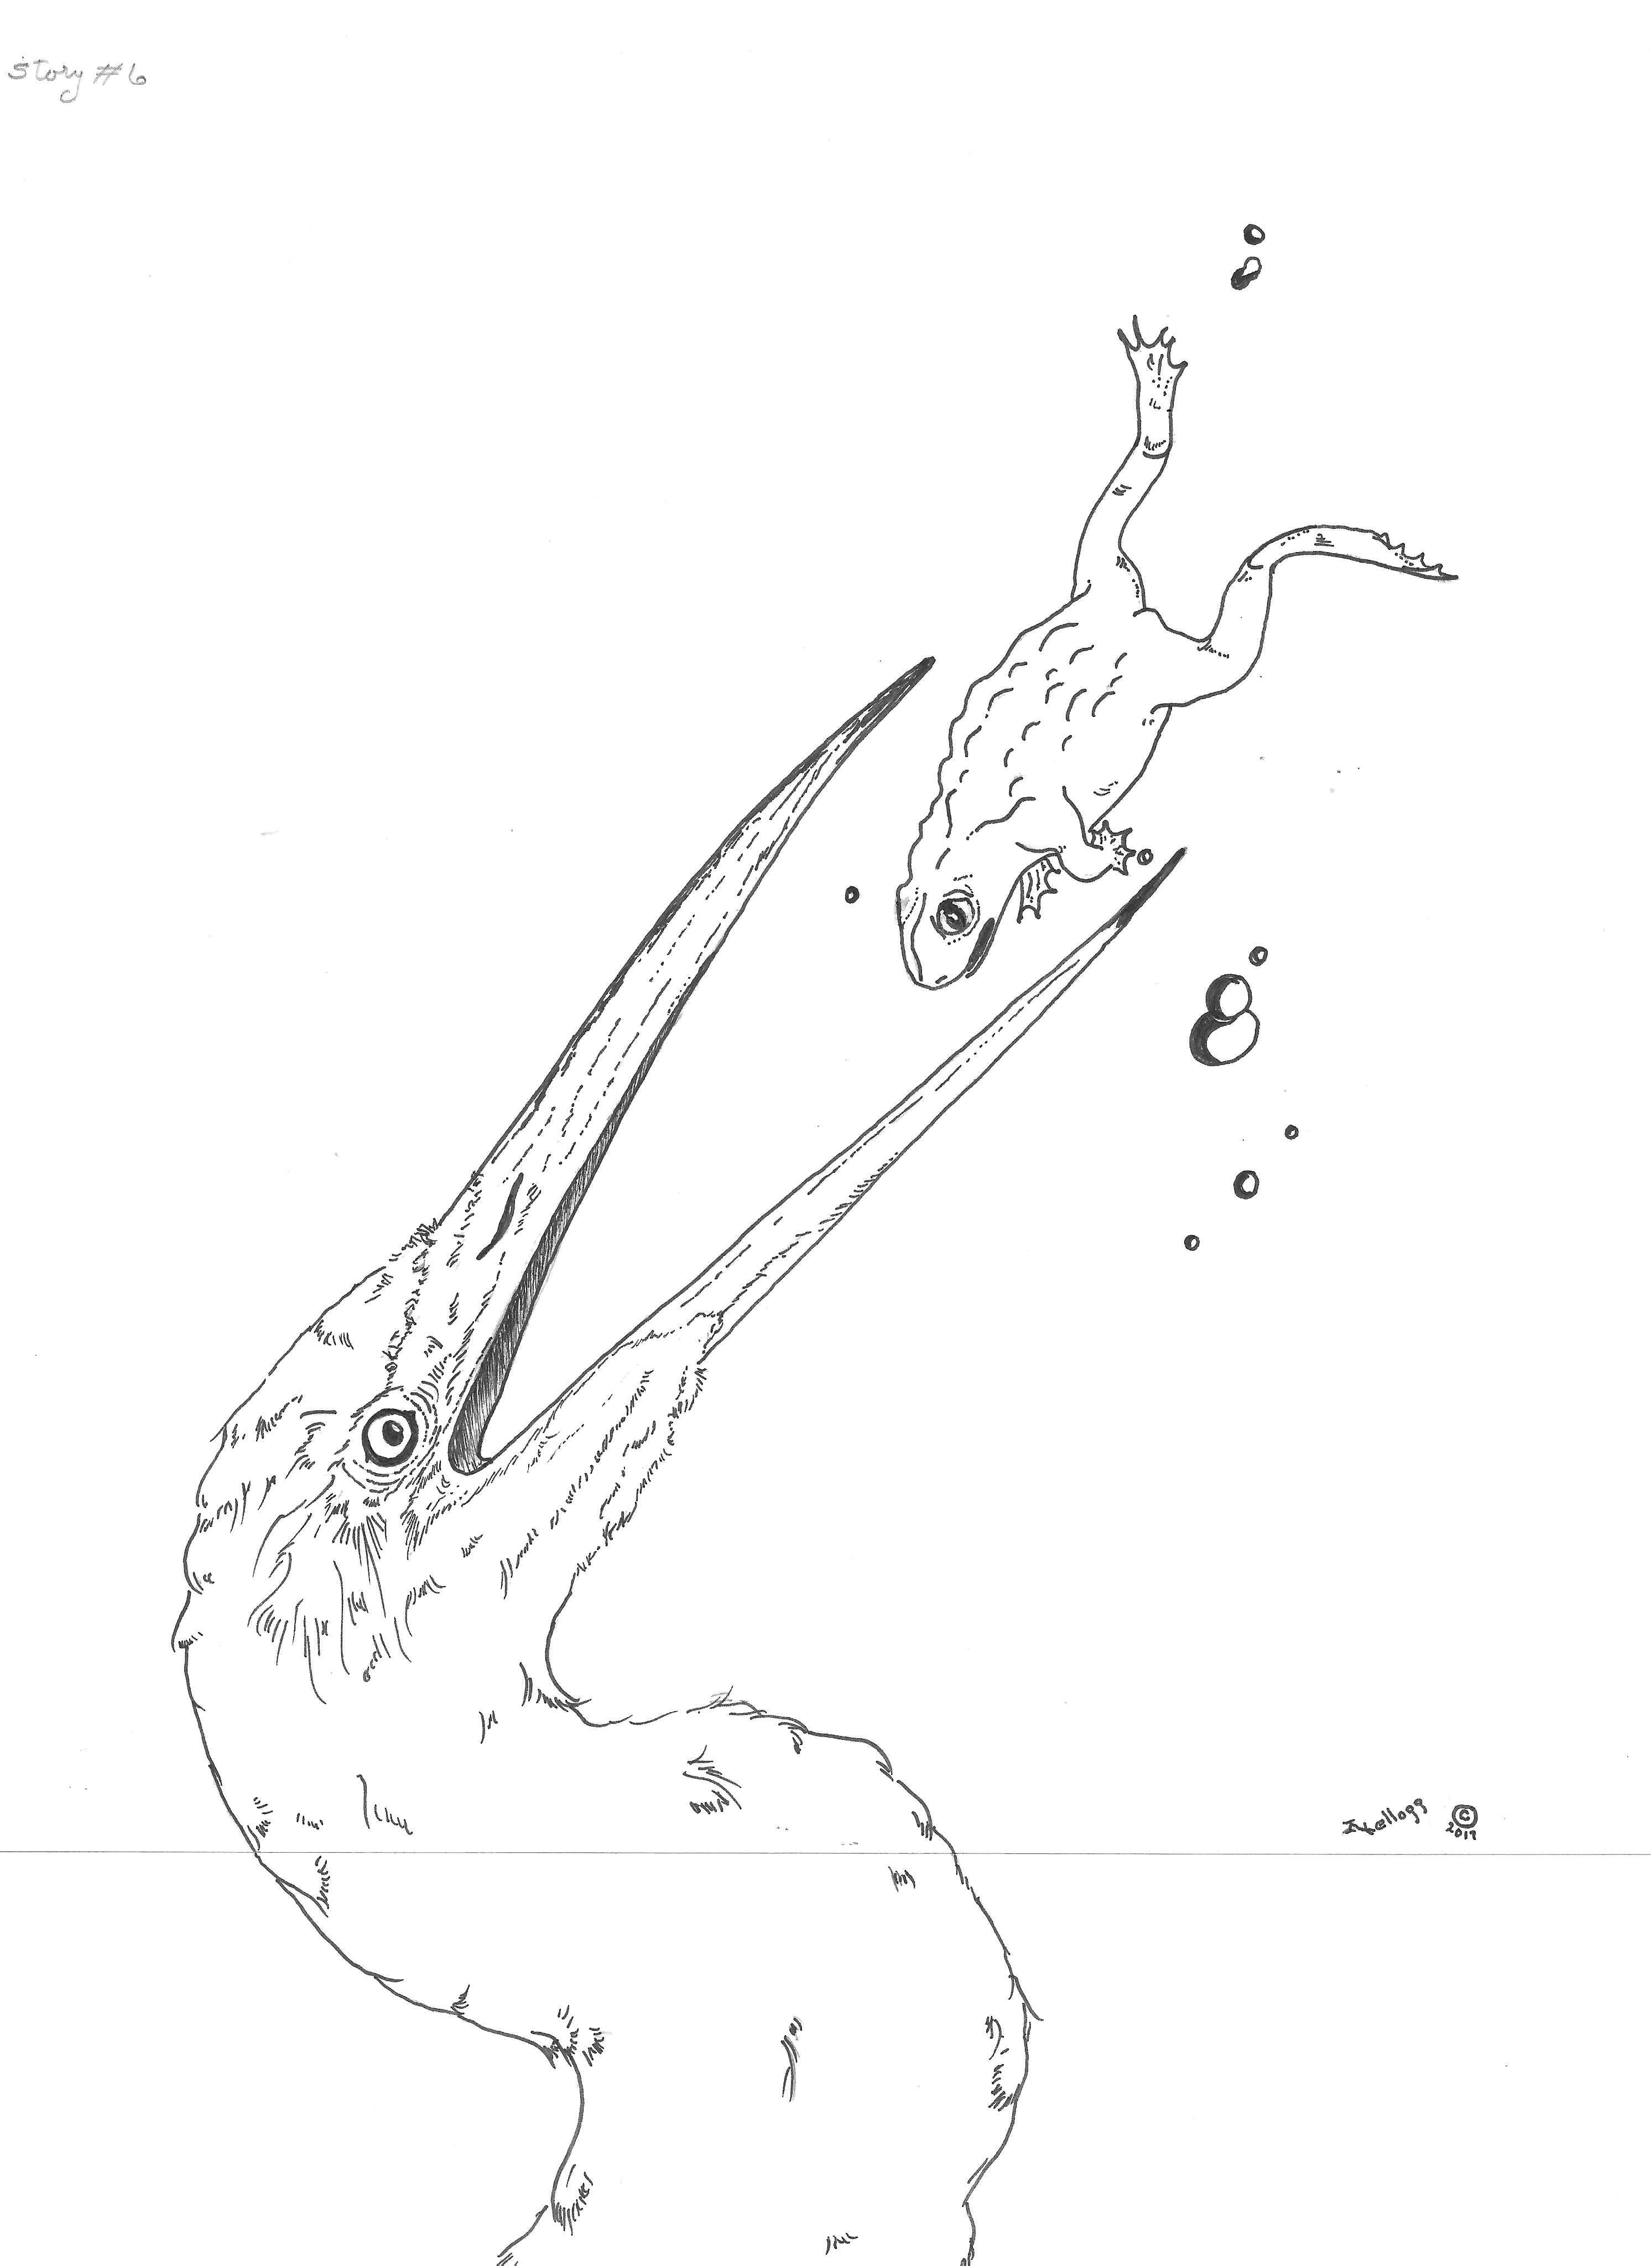

Slide 3
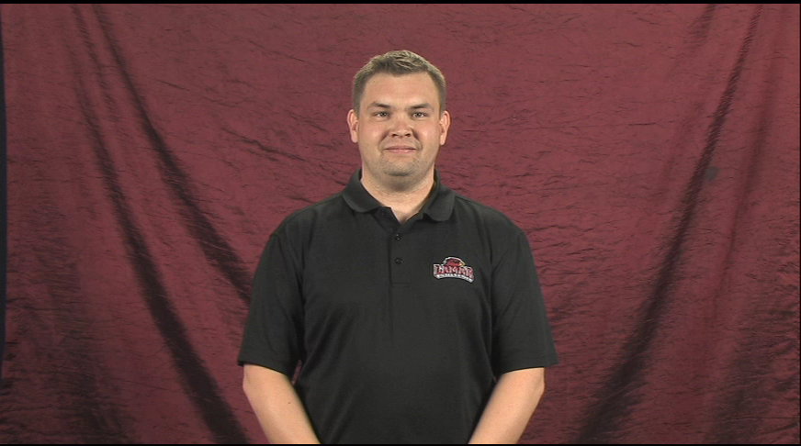
Story #6
The Hungry Great Egrets

Slide 4
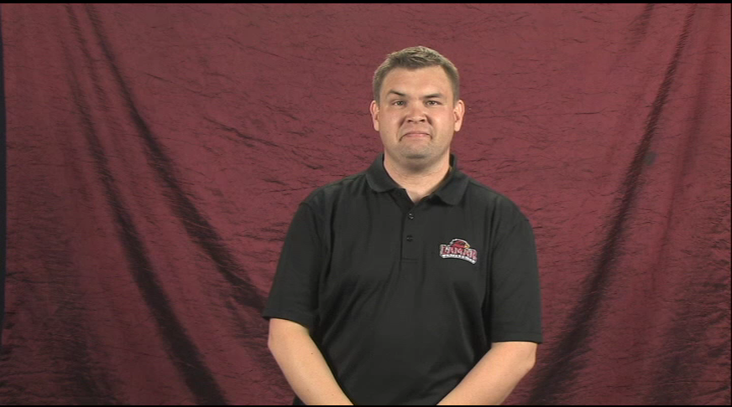
From their high nest, female great egret flies down to a cypress stump.

Slide 5
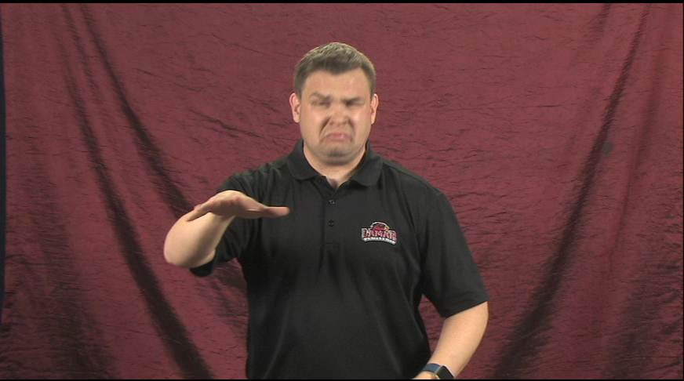
When she wades in the water, a big, brown frog jumps on a nearby log.

Slide 6
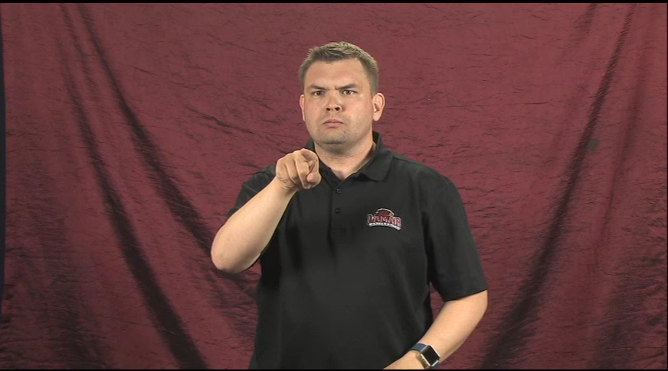
She snatches the frog with her bill, flips it and eats it.

Slide 7
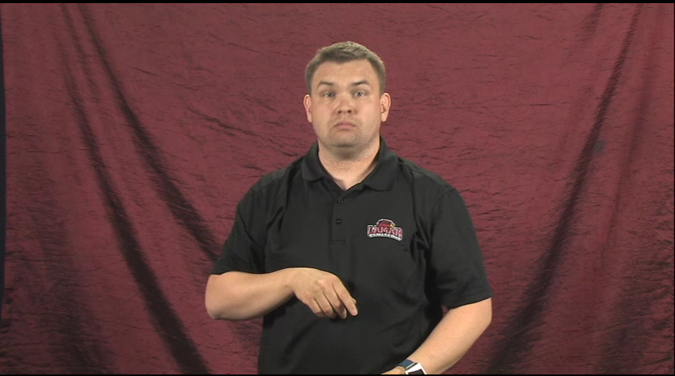
Male great egret wades nearby in shallow water.

Slide 8
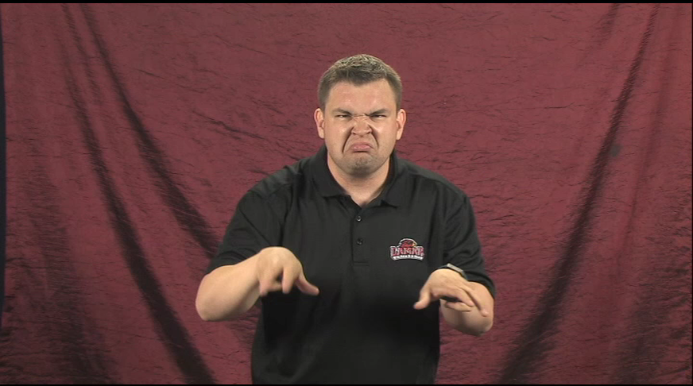
He scratches his claws across the muddy lake bottom.

Slide 9
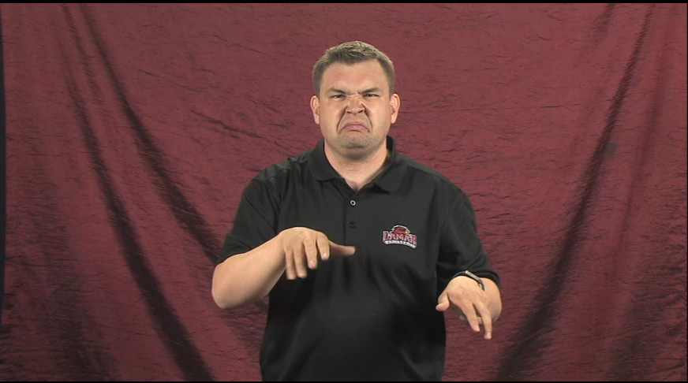
He stirs the mud and stands quietly.

Slide 10
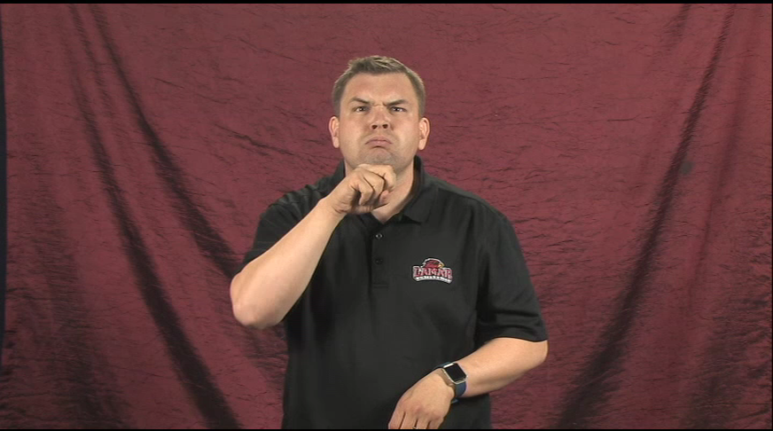
A big brown frog swims across his big claws.

Slide 11
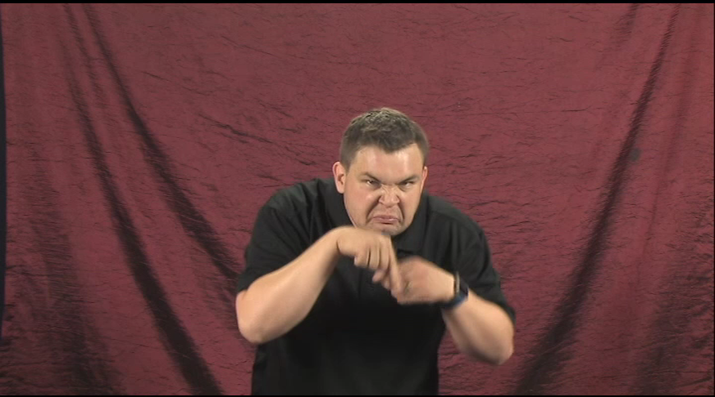
He grabs the frog with his bill.

Slide 12
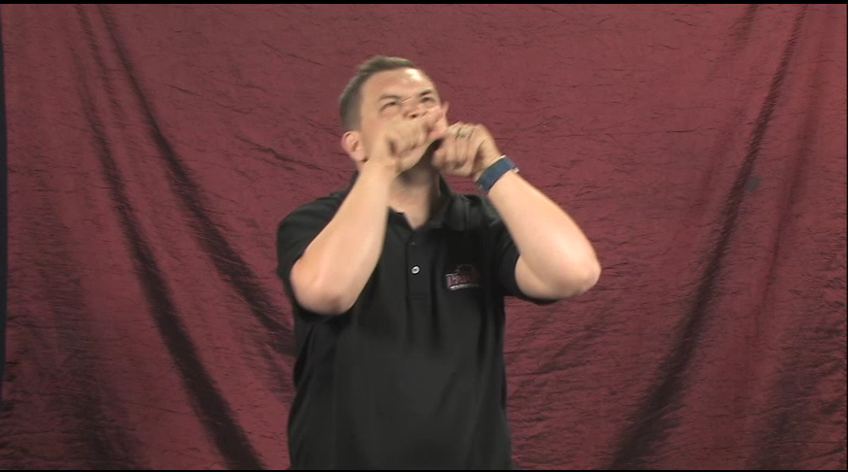
He flips the frog and it almost disappears.

Slide 13
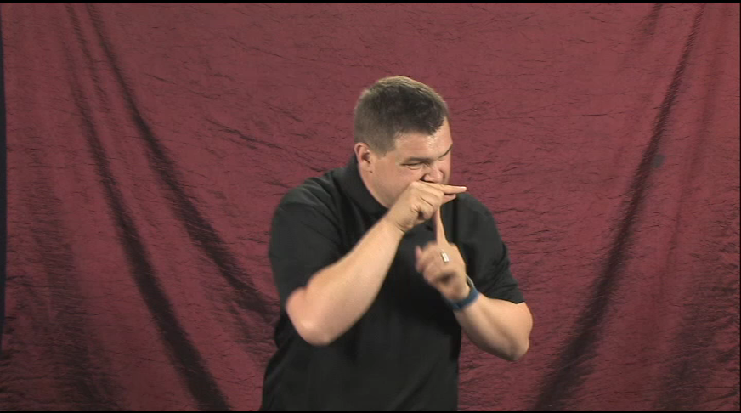
Then he taps his bill against a low branch.

Slide 14
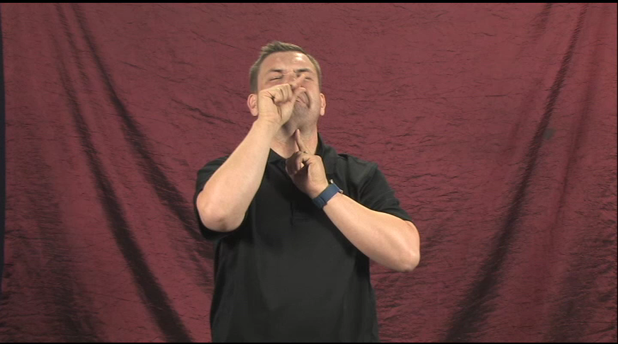
Now frog slithers down his throat.

