Slide 1
Story #11
The Three Fledglings Go Fishing

Slide 2
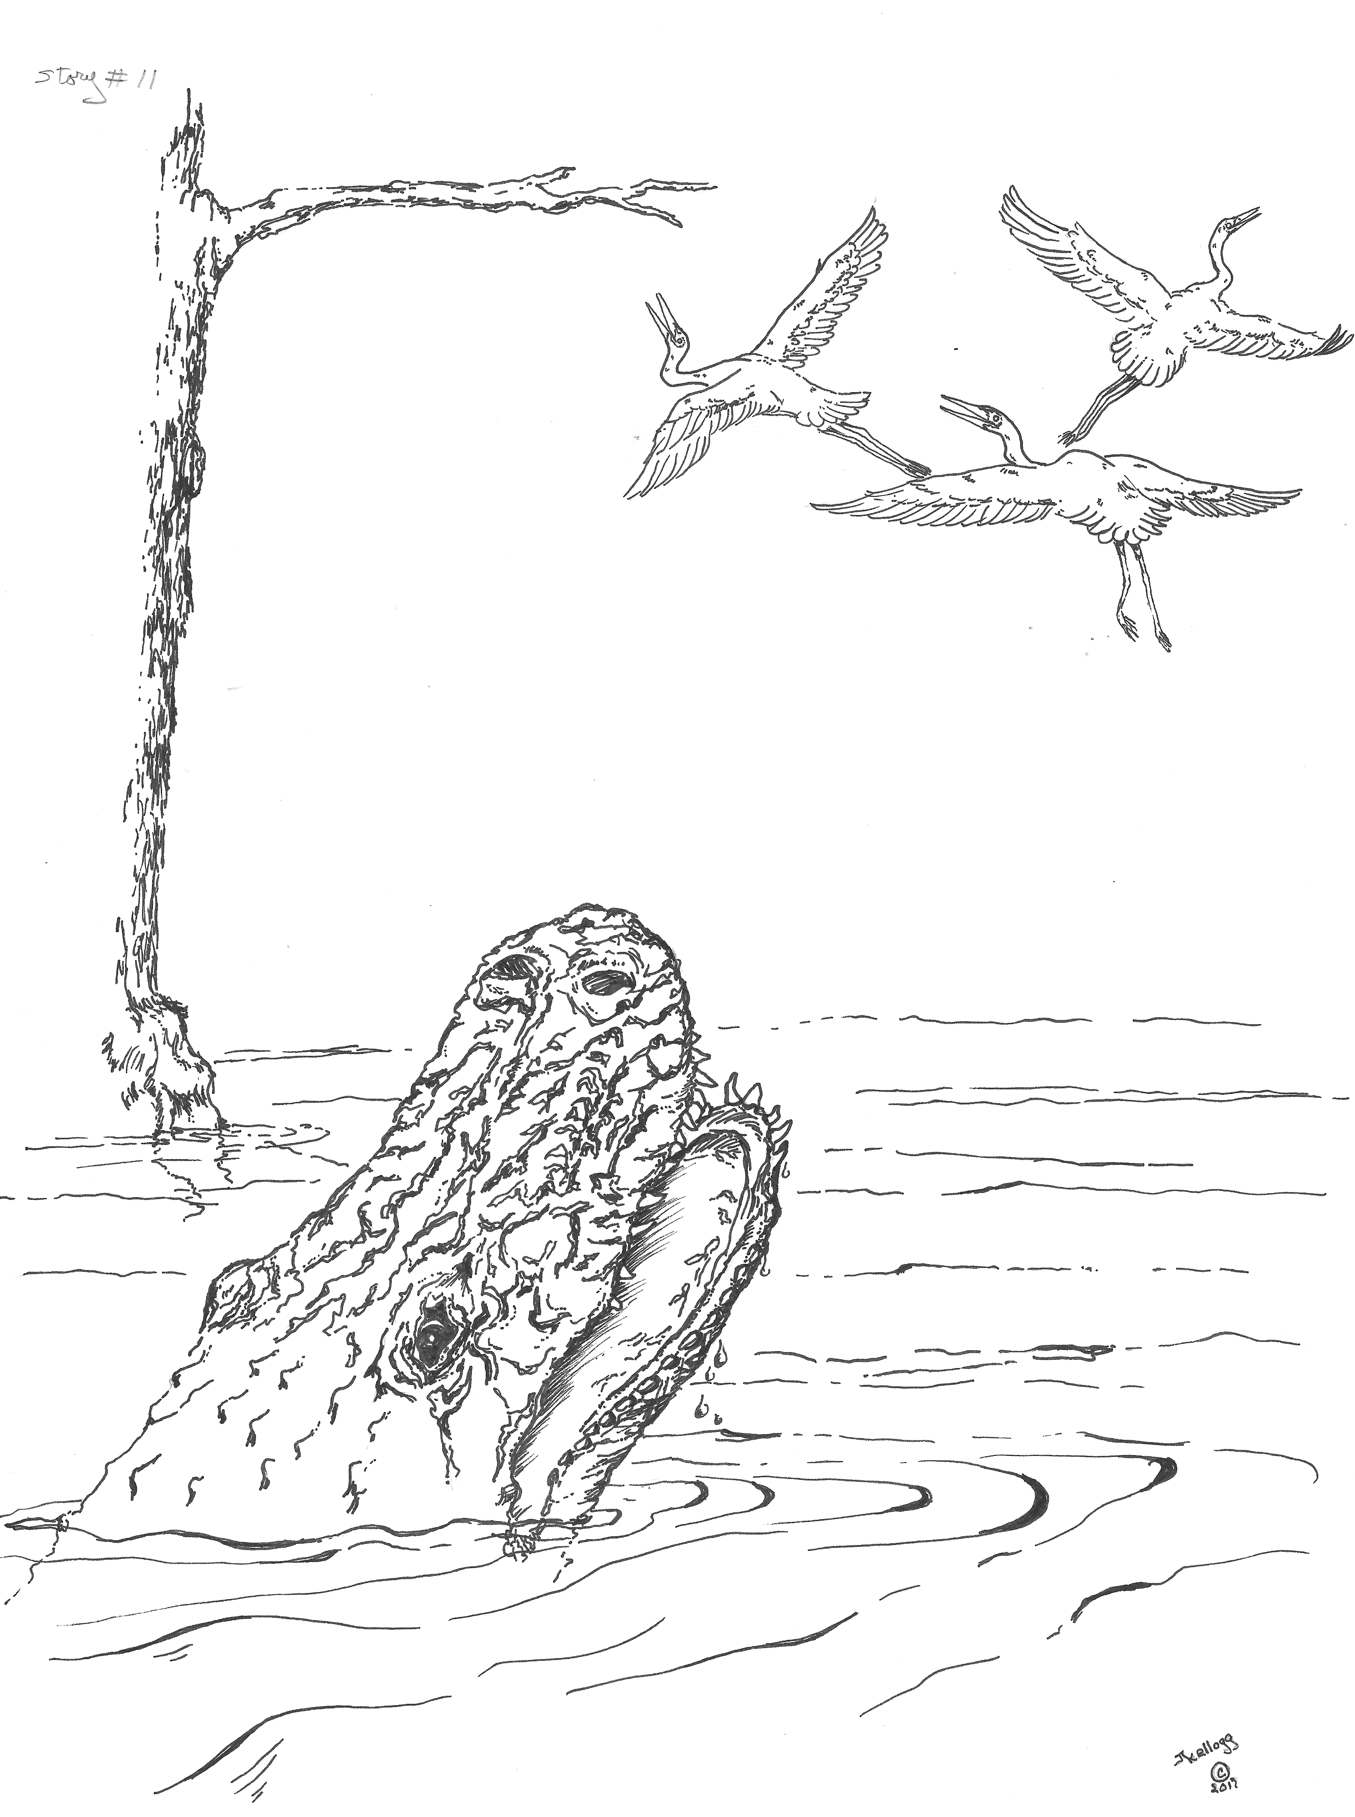

Slide 3
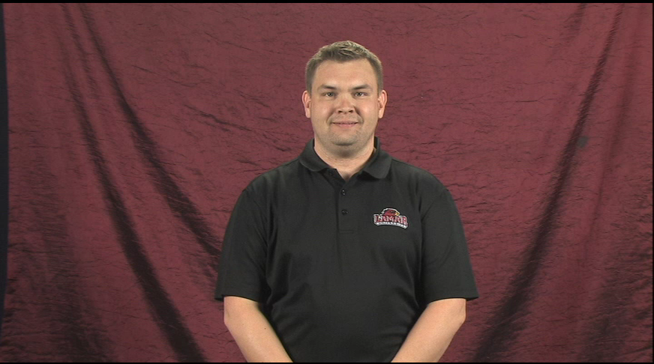
Story #11: The Three Fledglings Go Fishing

Slide 4
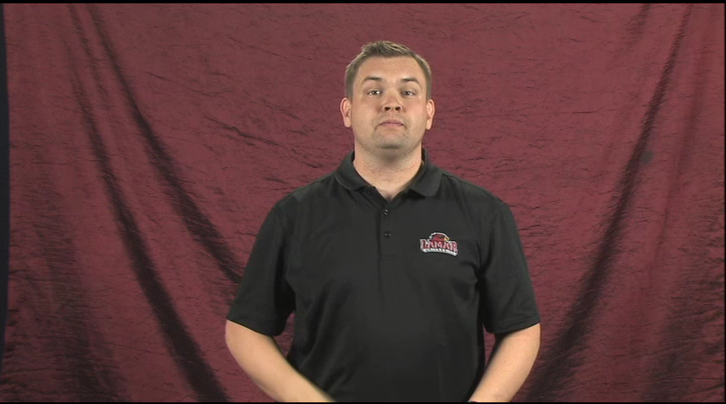
The three fledglings fly to the edge of the lake.

Slide 5
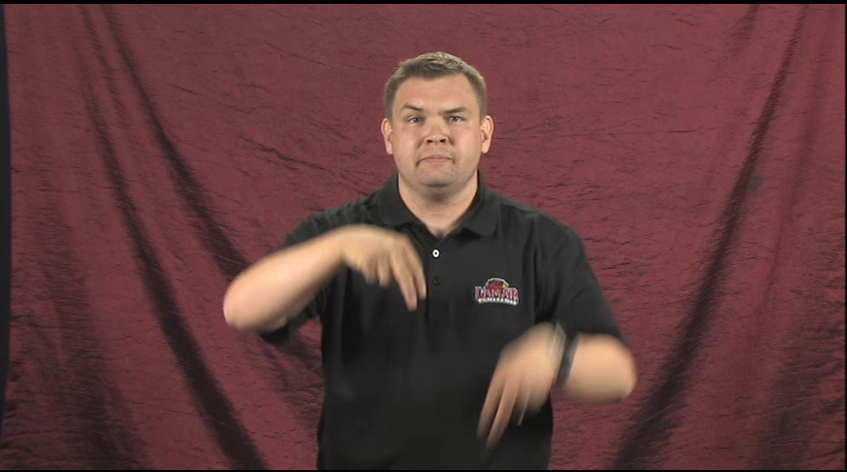
They stand still in the water looking for fish to catch.

Slide 6
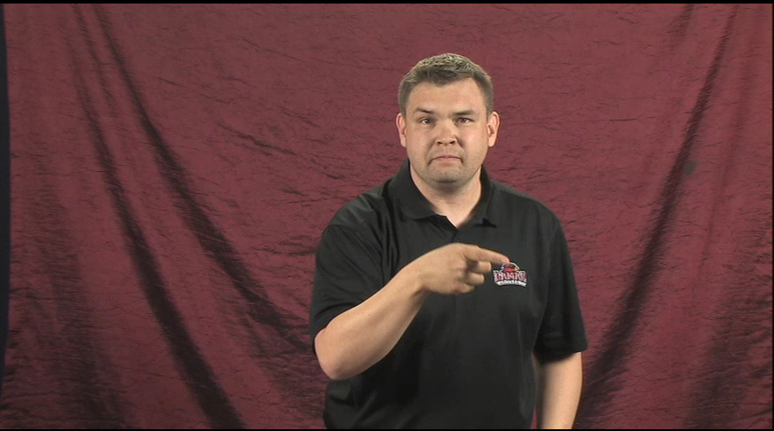
A long dark shadow swims towards the fledglings.

Slide 7
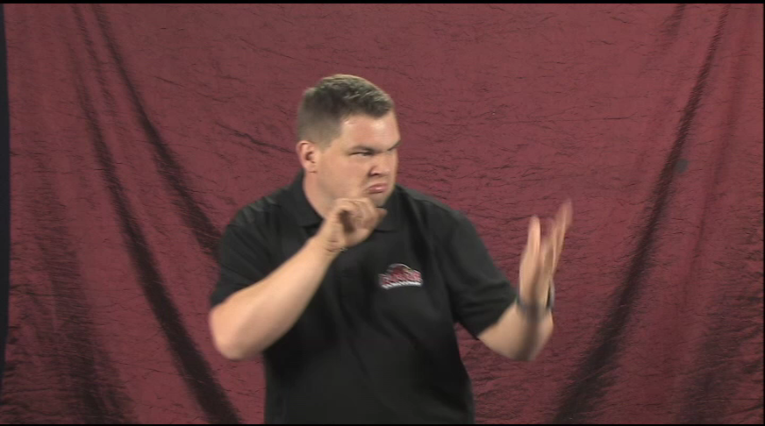
Closer and closer comes hungry alligator.

Slide 8
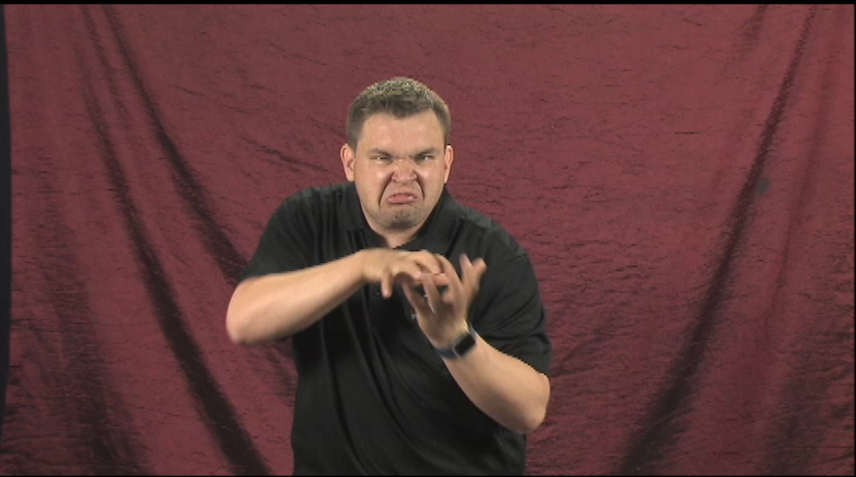
The hungry alligator has big jaws with sharp teeth.

Slide 9
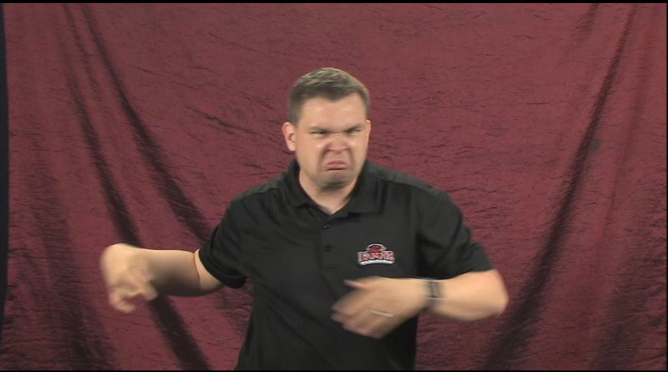
His strong tail moves back and forth in the water.

Slide 10
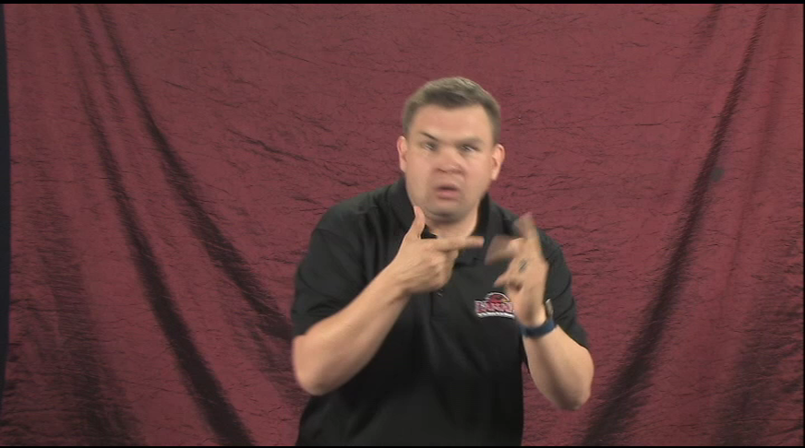
Flap, flap flap, the young fledglings fly to a cypress branch.

Slide 11
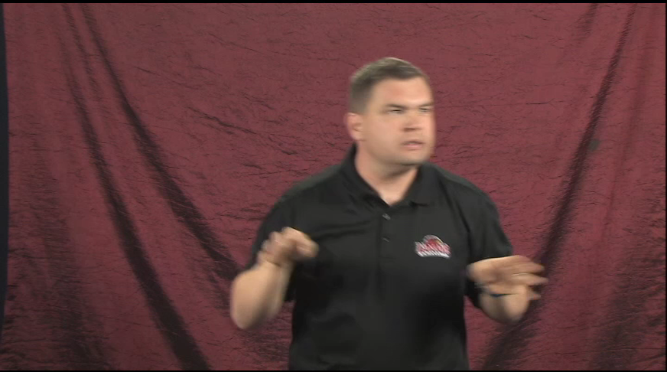
No young egrets are here NOW for Alligator to eat!!

Slide 12
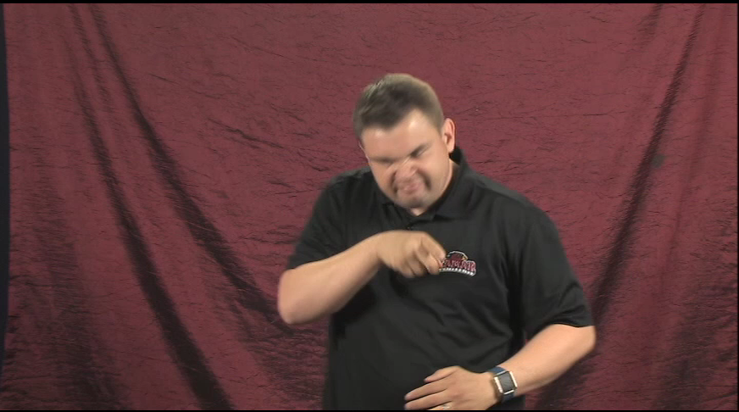
Hungry alligator swims away.

