Slide 1
Story #10
Baby Chicks Grow Bigger and Bigger

Slide 2
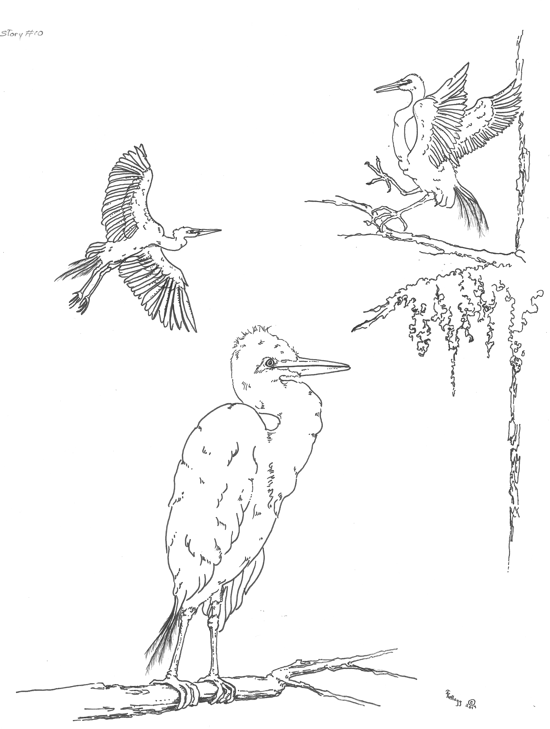

Slide 3

Story #10: Baby Chicks Grow Bigger and Bigger

Slide 4

The baby chicks’ legs are longer and stronger.

Slide 5

Their wings grow longer and stronger.

Slide 6

The baby chicks are now fledglings.

Slide 7

But the nest is too small for the fledglings.

Slide 8
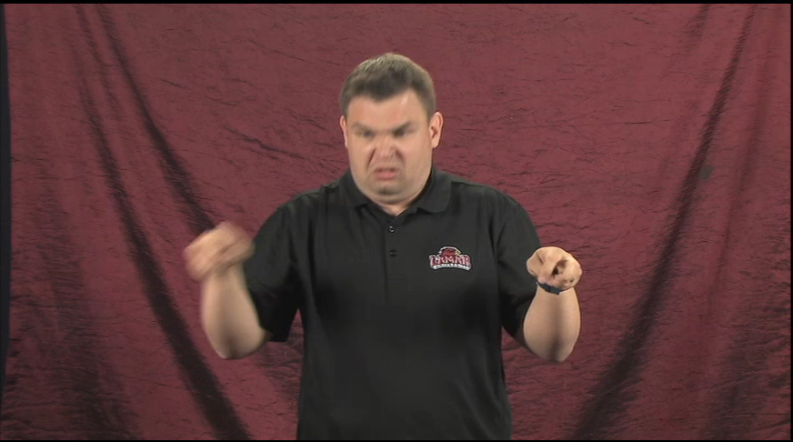
So they leap up and down and push each other in the bouncing nest.

Slide 9
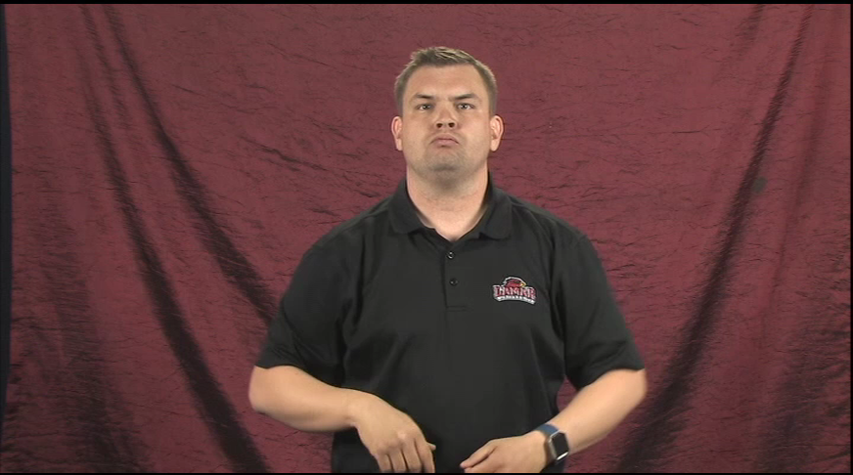
They are so strong they can fly-hop to nearby branches.

Slide 10

Mother and father egret bring food to the fledglings.

Slide 11

One by one, they snatch the fish from mother and father.

Slide 12

Then one fledgling flaps his wings and flies to a nearby branch.

Slide 13
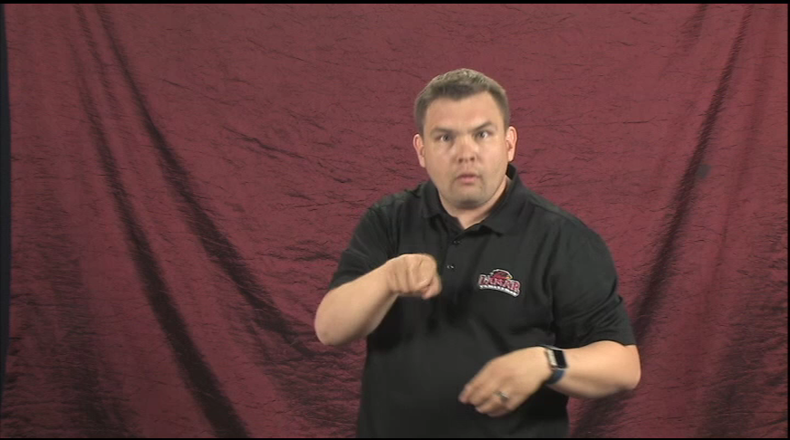
Another fledgling follows and perches on another branch.

Slide 14
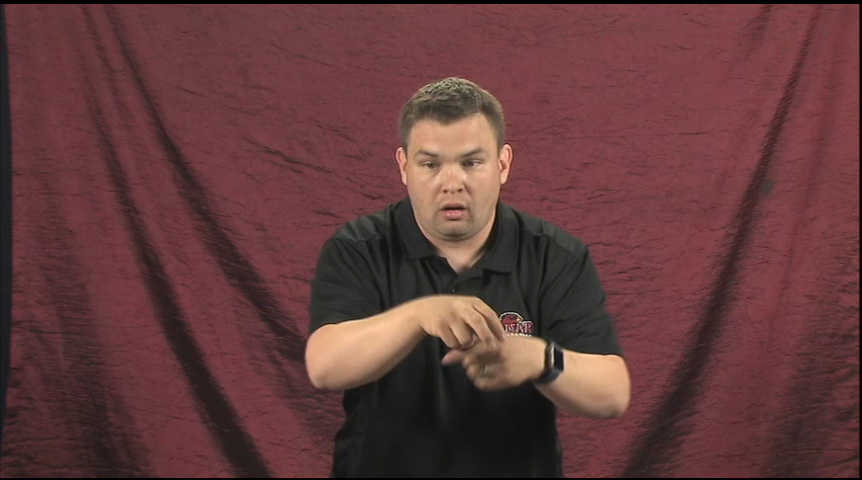
The third fledgling flies to a different tree.

Slide 15

Then they fly back to the nest.

Slide 16

They flap their wings and cry, “KRAAK! KRAAK! KRAAK!”

